Slide 1
Identifying COVID-19 Through Symptomatic Indicators
Presented by:
Divya Mamuru
Likitha Vadla
Nikhith Krishna Vinduru

Slide 2
GOAL
To develop a model capable of predicting whether an individual is COVID-19 positive or negative based on their symptoms
To minimize the instances where a positive case is incorrectly identified as negative, i.e. aiming for a false positive rate of less than 5%.
Implementing a machine learning model that can accurately and reliably classify the data in the dataset in a timely manner.

Slide 3
OBJECTIVE
To develop an optimal model that can accurately predict the target variable by assessing the performance of each individual model.
To implement a diverse set of machine learning algorithms such as
Support Vector Machines
Decision Trees
Voting classifier
Fine-tuning hyperparameters and use a voting classifier to improve accuracy.
Next, use the identified best model to categorize the test dataset.

Slide 4
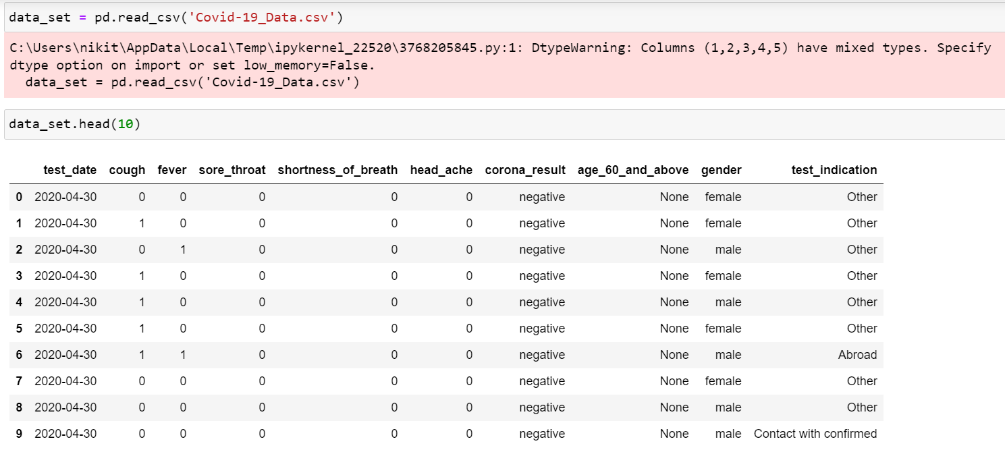
DATASET
https://data.gov.il/dataset/covid-19 (English) – Source of the Dataset https://www.kaggle.com/datasets/imdevskp/corona-virus-report - For Additional Research

Slide 5
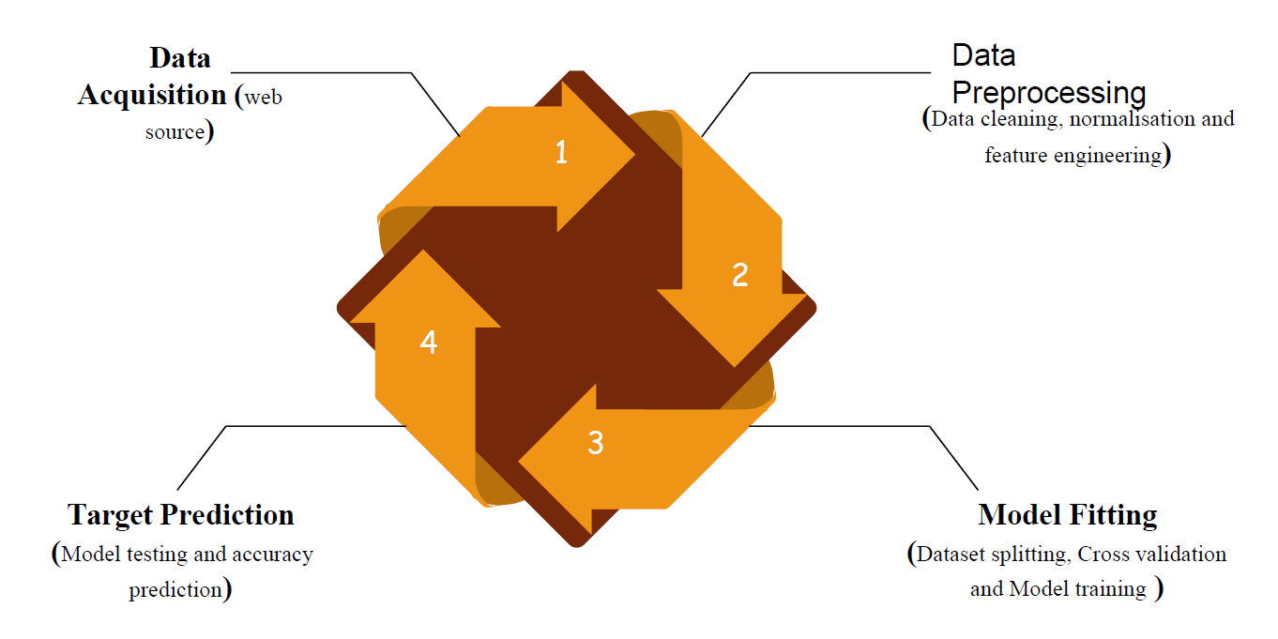
APPROCH
Tools – Anconda (Jupyter Notebook)

Slide 6
ALGORITHMS
Logistic regression is a statistical method for analyzing a dataset in which there are one or more independent variables that determine an outcome, typically a binary outcome.
K-nearest neighbors, is a non-parametric machine learning algorithm used for classification and regression, where an object is classified by the majority class of its k-nearest neighbors in a feature space.
SVM, or Support Vector Machines, is a supervised machine learning algorithm used for classification and regression, which separates data points into different classes by finding the hyperplane that maximizes the margin between the classes.

Slide 7
EVALUATION METHODOLOGY
Confusion Matrix : for finding False Positive, True Positive, false Negative, True Negative
F1-score
Accuracy(>95)
Time Complexity
Correctness
Feature importance: You have the choice to evaluate the importance of each feature in your final model using either in-built or external algorithms
Decision boundary visualization

Slide 8
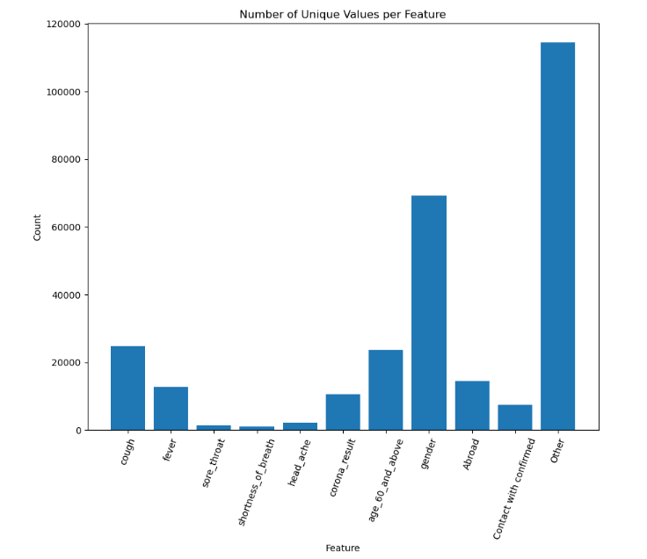
OUTPUT VISUALIZATIONS
UNIQUE VALUE PER FEATURE

Slide 9
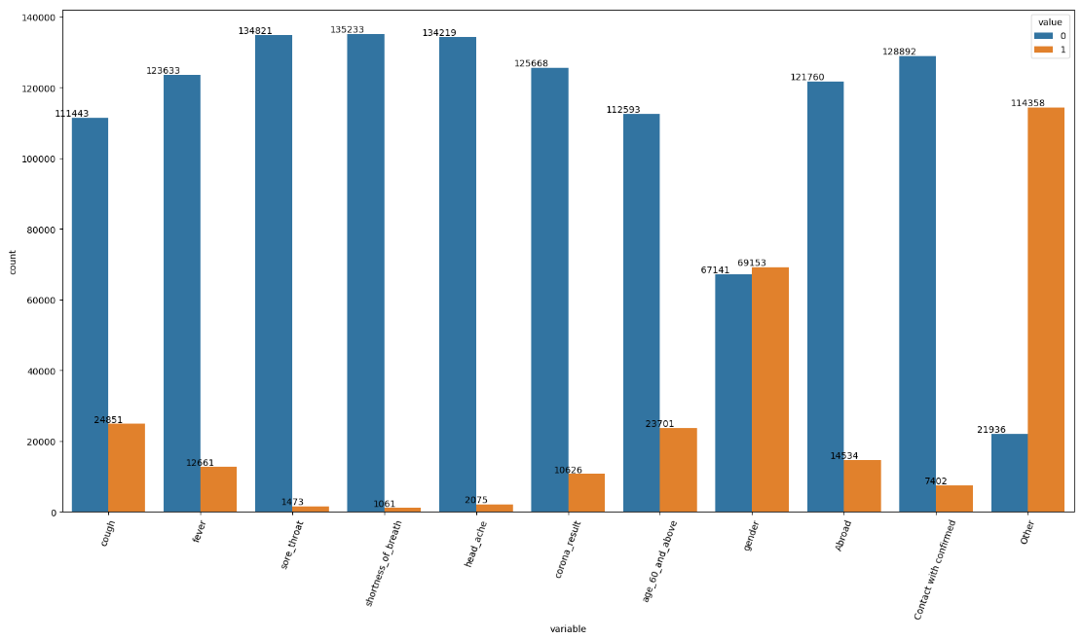
OUTPUT VISUALIZATIONS
COUNT OF THE EACH VARIABLE

Slide 10
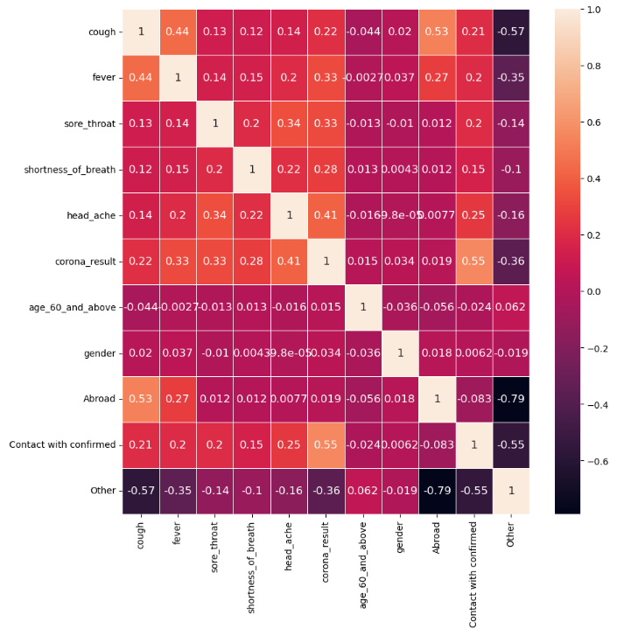
OUTPUT VISUALIZATIONS
HEAT MAP OF THE CORRELATION MATRIX FOR THE VARIABLES

Slide 11
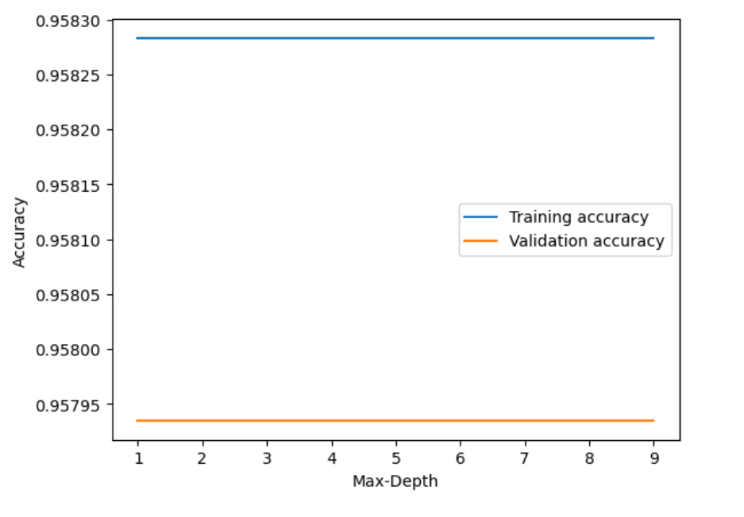
OUTPUT VISUALIZATIONS
TRAINING AND VALIDATION ACCURACY SCORES ACROSS DIFFERENT VALUES OF MAX-DEPTH

Slide 12
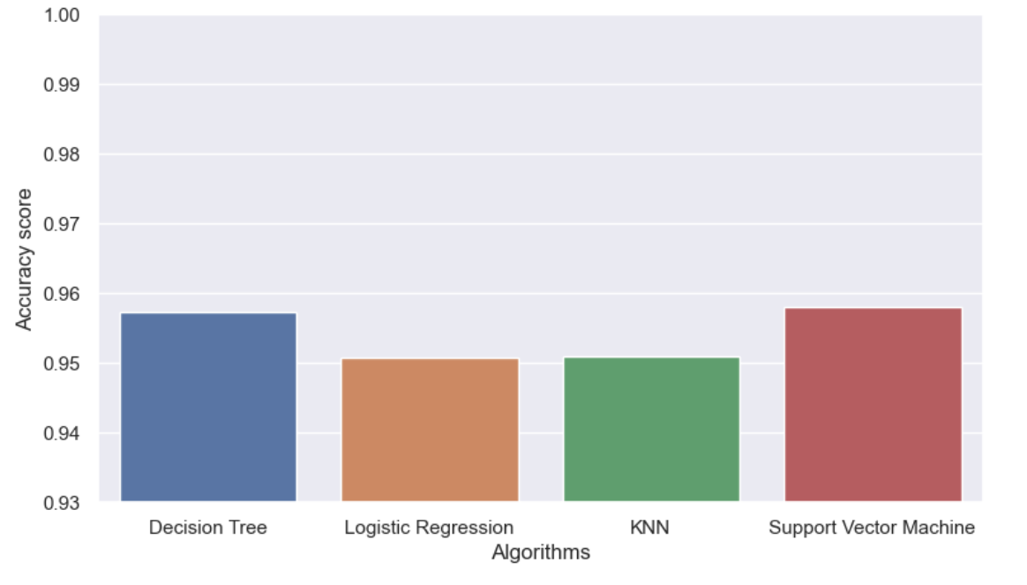
OUTPUT VISUALIZATIONS
ACCURACY SCORES OF THE DIFFERENT ALGORITHMS

Slide 13
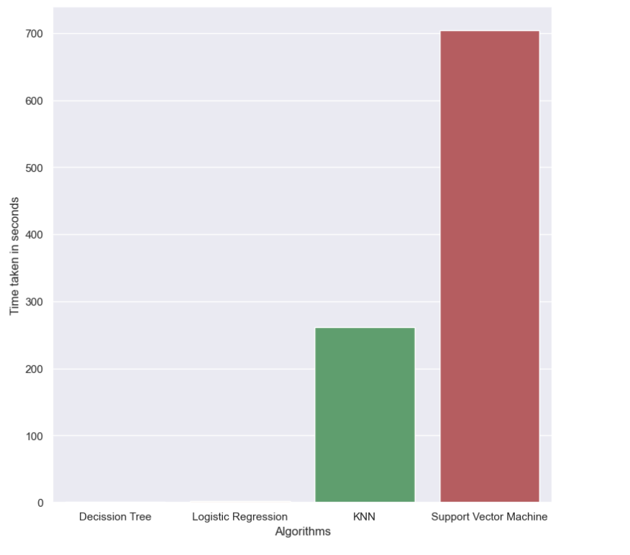
OUTPUT VISUALIZATIONS
TIME TAKEN IN SECONDS FOR THE DIFFERNET ALGORITHMS

Slide 14
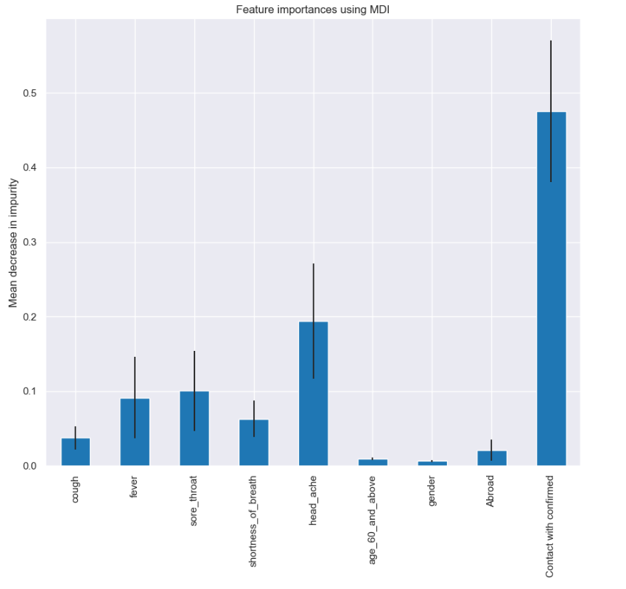
OUTPUT VISUALIZATIONS
MEAN DECREASE IN IMPURITY (MDI)

Slide 15
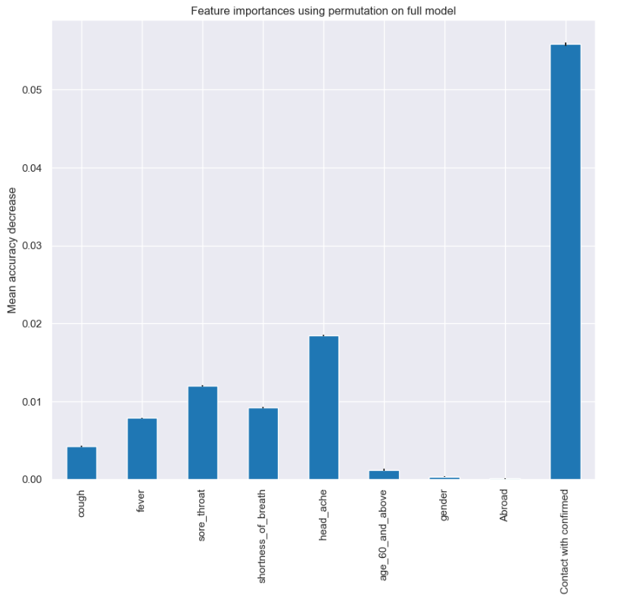
OUTPUT VISUALIZATIONS
MEAN ACCURACY DECREASE

Slide 16
DELIVERABLES
A user documentation guide providing detailed information about the functioning of the model
A Python document containing classification machine learning algorithms developed in the Python programming language
GitHub repository link for project code and related files
A YouTube video showing the project implementation and slides

Slide 17
CONCLUSION:
In conclusion, the project aimed to develop an accurate machine learning model for COVID-19 prediction based on symptoms, targeting a false positive rate below 5%. Utilizing diverse algorithms, hyperparameter tuning, and evaluation metrics like Confusion Matrix and F1-score, the study focused on achieving high accuracy (>95%) and timely classification while assessing model correctness and feature importance.
To enhance accuracy, alternative approaches such as clustering, association rules, and genetic algorithms could be considered. Nevertheless, recognizing the constraints of this study, the pursuit of more sophisticated and integrated models is essential for achieving higher accuracy in early COVID-19 prediction.

